Slide 1

Cassandra
—— A Decentralized Structured Storage System

Slide 2
Reference
Lakshman, Avinash, and Prashant Malik. “Cassandra: a decentralized structured storage system.” ACM SIGOPS Operating Systems Review 44.2 (2010): 35-40.
http://docs.datastax.com/en/
http://learn.infiniteskills.com/
https://cs.uwaterloo.ca/~tozsu/courses/CS848/W15/presentations/Cassandra.pdf
http://tinman.cs.gsu.edu/~bjayakumar2/Final/report.pdf
http://www.tutorialspoint.com/cassandra/cassandra_referenced_api.htm

Slide 3
Outline
Introduction
Data Model
Query Language
System architecture

Slide 4
Introduction

Slide 5
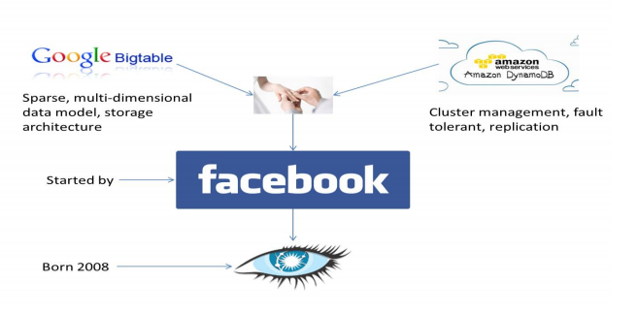
History
latest version: 3.0.5
Notes:
Column Families • Memtables • SSTables from google big table
Consistent hashing • Partitioning • Replication from dynamo

Slide 6
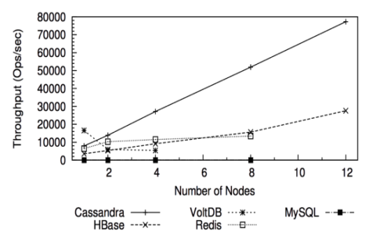
Motivations
High Scalability: Read/write throughput increases linearly when number of nodes increases
High Availability: Cassandra treats failures as the norm rather than exception
High write throughput: By efficient disk access policy and flexible consistency level

Slide 7
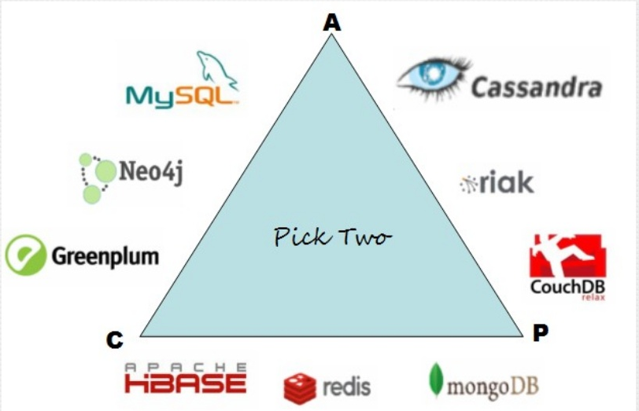
Cassandra & CAP
Notes:
CAP theorem : In any given system, we can strongly support only two out of consistency, availability and partition tolerance

Slide 8
Data Model

Slide 9
Data Model
spreads data
over nodes
Multiple columns
per key
A table is a distributed multi-dimensional map indexed by a key
string with
no size restriction

Slide 10
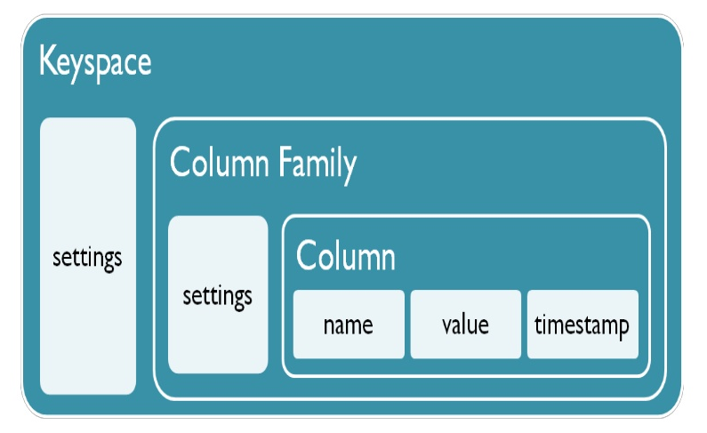
Data Model
Notes:
From: http://www.slideshare.net/sameiralk/cassendra

Slide 11
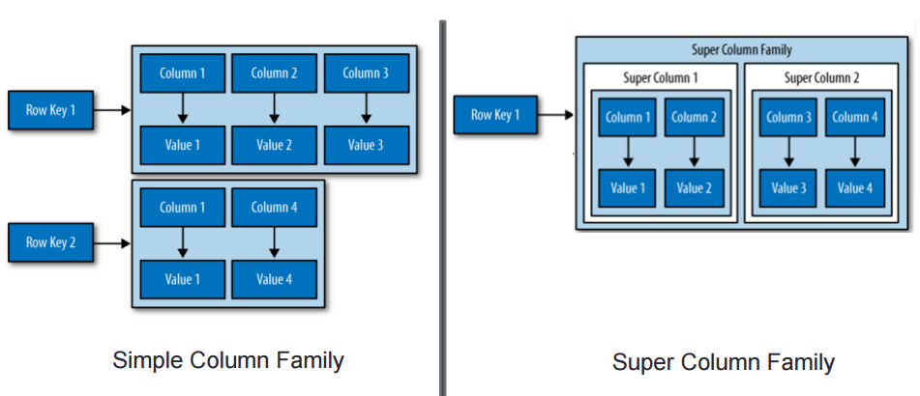
Data Model
Notes:
https://cs.uwaterloo.ca/~tozsu/courses/CS848/W15/presentations/Cassandra.pdf

Slide 12
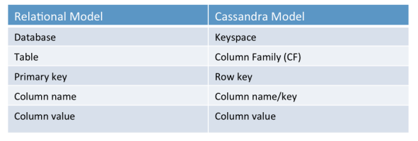
Data Model
Relational model and Cassandra model comparison
Notes:
Supercolumns are gone. “Column families” have been replaced by tables, by:http://docs.datastax.com/en/articles/cassandra/cassandrathenandnow.html

Slide 13
Query Language

Slide 14
Query Language
API
insert(table; key; rowMutation)
get(table; key; columnName)
delete(table; key; columnName)
-- CQL offers since v1.2

Slide 15
CQL CURD Operations
INSERT INTO <tablename>
(<column1 name>, <column2 name>....)
VALUES (<value1>, <value2>....)
USING <option>
UPDATE <tablename>
SET <column name> = <new value>
<column name> = <value>....
WHERE <condition>
SELECT FROM <table name> WHERE <condition>
DELETE FROM <identifier> WHERE <condition>

Slide 16
Cassandra Architecture

Slide 17
Cassandra Architecture
Partitioning
Replication
Membership
Bootstrapping
Scaling the Cluster
Local Persistence

Slide 18
Basic Knowledge
Cassandra is a distributed database
the data will be spread to several different servers
In Cassandra, cluster is a group of nodes, linked by network.
In each cluster, no master nodes, no slave nodes
Each nodes have the same functionality.
Notes:
Rather than put all the data in

Slide 19
Basic Knowledge
Cluster1(span physical locations)
Data Center1(never span physical location)
rack1
nodes1(basic infrastructure component of Cassandra)
nodes2
rack2
nodes3
Data Center2
nodes4
Cluster2
Data Center3
…
Notes:
Node
Where you store your data. It is the basic infrastructure component of Cassandra.
Data center
A collection of related nodes. A data center can be a physical data center or virtual data center. Different workloads should use separate data centers, either physical or virtual. Replication is set by data center. Using separate data centers prevents Cassandra transactions from being impacted by other workloads and keeps requests close to each other for lower latency. Depending on the replication factor, data can be written to multiple data centers. However, data centers should never span physical locations.
Cluster
A cluster contains one or more data centers. It can span physical locations.

Slide 20
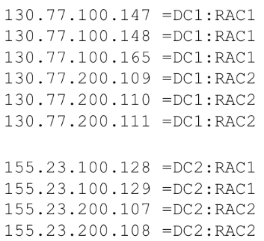
Basic Knowledge
Cluster1(span physical locations)
Data Center1(never span physical location)
rack1
nodes1(basic infrastructure component of Cassandra)

Slide 21
Basic Knowledge--Snitch
Snitch is how the nodes in a cluster know the network topology of the cluster
A snitch determines which data centers and racks nodes belong to.
SimpleSnitch
default
PropertyFileSnitch
Determines the location of nodes by rack and data center

Slide 22
Basic Knowledge-- Snitch
Cluster1(span physical locations)
Data Center1(never span physical location)
rack1
nodes1(basic infrastructure component of Cassandra)

Slide 23
Basic Knowledge-- Gossip
Gossip is how nodes communicate with each other
Every one second, each node communicate with up to three other nodes, exchanging information about it self and all the other nodes that it has information about

Slide 24
Basic Knowledge-- Gossip
Gossip is the internal communication method for nodes in cluster to talk with each other
For external communication, such from an application to an Cassandra database, CQL or Thrift are used

Slide 25
Cassandra Architecture
Partitioning
Replication
Membership
Bootstrapping
Scaling the Cluster
Local Persistence

Slide 26
Partitioning
Goal: even distribution of data across the nodes in a cluster
Rather than all rows of a table existing on only one table, the rows are distributed across the nodes in the cluster
Partitioning is done through consistent hashing

Slide 27
Consistent hashing
Consistent hashing allows distribution of data across a cluster to minimize reorganization when nodes are added or removed.
In consistent hashing, the output range of a hash function is treated as a fixed circular space or “ring” (i.e. the largest hash value wraps around to the smallest hash value).
Pratitioner in Cassandra: Murmur3
Murmur3 takes the value of partition key of row to generate a unique number between -2⁶⁴ and 2⁶³

Slide 28
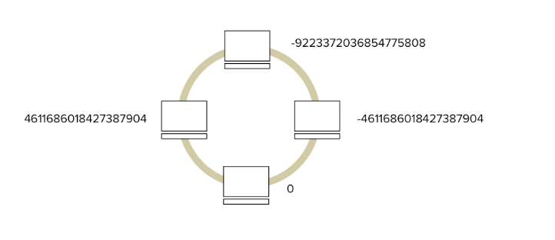
Consistent hashing

Slide 29
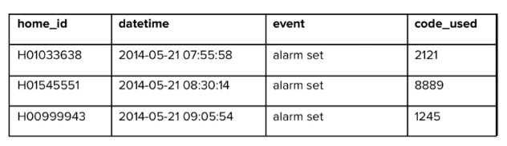
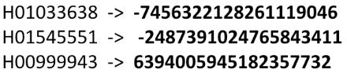
Partitioning

Slide 30
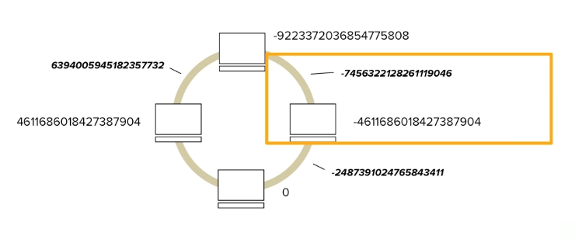
Partitioning

Slide 31
Cassandra Architecture
Partitioning
Replication
Membership
Bootstrapping
Scaling the Cluster
Local Persistence

Slide 32
Replication
A replication factor must be specified whenever a database is defined
Common to specify 2,3 replica that if a node goes down, there is at least one other replica.

Slide 33
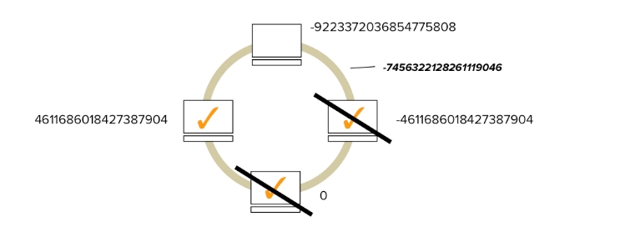
Replication

Slide 34
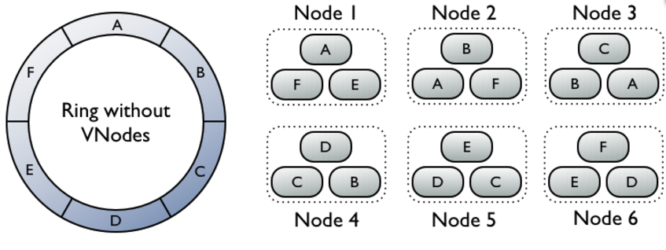
Replication

Slide 35
Cassandra Architecture
Partitioning
Replication
Membership
Bootstrapping
Scaling the Cluster
Local Persistence

Slide 36
Scaling the Cluster--Virtual nodes
another way to assign token ranges to nodes
right now default in Cassandra
With virtual nodes, instead of node being responsible for just one token range, it is instead responsible for many small token ranges(by default, 256)
Goal: easy to add new nodes with keeping cluster balanced
when there is a new node, it received many small token range slices from the existing nodes, to maintain a balanced cluster

Slide 37
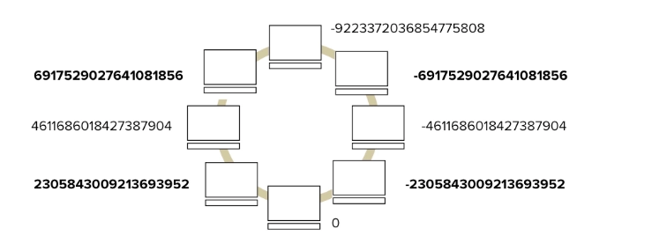
Static token ranges
double the number of nodes, without change the end-point
values of existing nodes
Notes:
without having to change the end-point values of existing nodes

Slide 38
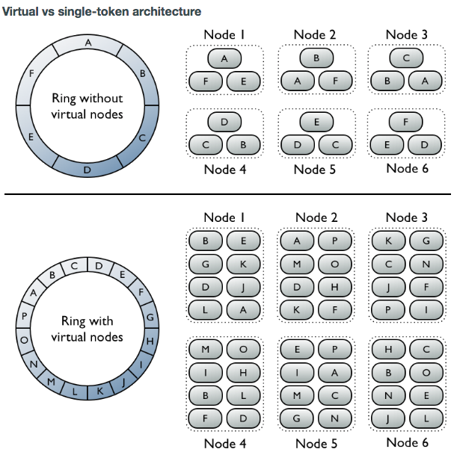
Virtual vs single-token architecture

Slide 39
Virtual vs single-token architecture
Notes:
A node dies completely, and we need to bring up a replacement. At this point the replacement node needs to get a replica for 3 different ranges to reconstitute not only the data it is the first natural replica for, but also data that it is a secondary/tertiary natural replica for (though do recall no replica has ‘priority’ over another in Cassandra, this terminology is strictly to illustrate placement on the ring.)

Slide 40
Virtual vs single-token architecture

Slide 41
Cassandra Architecture
Partitioning
Replication
Membership
Bootstrapping
Scaling the Cluster
Local Persistence

Slide 42
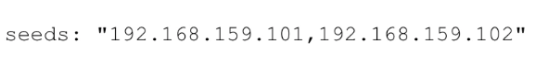
Bootstrapping
Adding nodes to an existing cluster
Seed nodes: regular nodes that providing a way(IP address) for new nodes to join the cluster
If a node want to join a cluster, at least one IP address is a must.
Seed nodes are specified in seed property of cassandra.yaml
Seed nodes cannot bootstrap
Notes:
Start Cassandra on each new node. Allow two minutes between node initializations.

Slide 43
Cassandra Architecture
Partitioning
Replication
Membership
Bootstrapping
Scaling the Cluster
Local Persistence

Slide 44
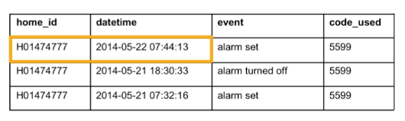
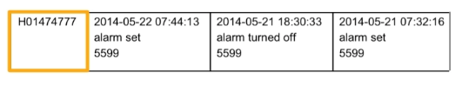
Local Persistence
A partition key value is what makes an rows unique

Slide 45
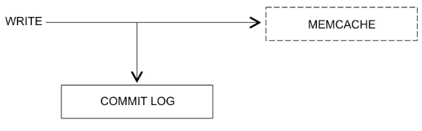
Local Persistence
When data is written to a table in Cassandra, it goes to both a commit log on disk(for playback, in case of node failure) and to memory (called memcache)

Slide 46
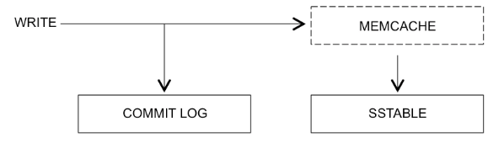
Local Persistence
Once the memcache for a table is full, it is flushed to disk, called SSTABLE
For each table on each node, there is one SSTABLE

Slide 47
Local Persistence
The SSTables for a table are stored on disk, in the location specified in the cassandra.yaml

Slide 48
Cassandra Architecture
Partitioning
Replication
Membership
Bootstrapping
Scaling the Cluster
Local Persistence

Slide 49
Membership—Failure Detection
Failure detection is a method for locally determining from gossip state and history if another node in the system is up or down.
Cassandra uses this information to avoid routing client requests to unreachable nodes whenever possible.

Slide 50
Membership—Failure Detection
Rather than have a fixed threshold for marking failing nodes, Cassandra uses an accrual detection mechanism to calculate a per-node threshold that takes into account network performance, workload, and historical conditions.
During gossip exchanges, every node maintains a sliding window of inter-arrival times of gossip messages from other nodes in the cluster.
Lower values increase the likelihood that an unresponsive node will be marked as down, while higher values decrease the likelihood that transient failures will cause a node failure.

Slide 51
Cassandra Architecture
Partitioning
Replication
Membership
Bootstrapping
Scaling the Cluster
Local Persistence

Slide 52
Implementation Details
About reads in Cassandra
About writes in Cassandra
Consistency

Slide 53
About reads in Cassandra
When a read request for a row comes in to a node, the row must be combined from all SSTables on that node that contain columns from the row in question, as well as from any unflushed memtables, to produce the requested data.

Slide 54
About writes in Cassandra
About Inserts and Updates
Any number of columns may be inserted at the same time. When inserting or updating columns in a column family, the client application specifies the row key to identify which column records to update.

Slide 55
About writes in Cassandra
About Inserts and Updates
Columns are only overwritten if the timestamp in the new version of the column is more recent than the existing column, so precise timestamps are necessary if updates (overwrites) are frequent.
The timestamp is provided by the client, so the clocks of all client machines should be synchronized using NTP (network time protocol).

Slide 56
About Deletes
Deleted data is not immediately removed from disk
Once an SSTable is written, it is immutable (the file is not updated by further DML operations).
This means that a deleted column is not removed immediately.
Instead a marker called a tombstone is written to indicate the new column status.
Columns marked with a tombstone exist for a configured time period (defined by the gc_grace_seconds value set on the column family), and then are permanently deleted by the compaction process after that time has expired.
Repair node

Slide 57
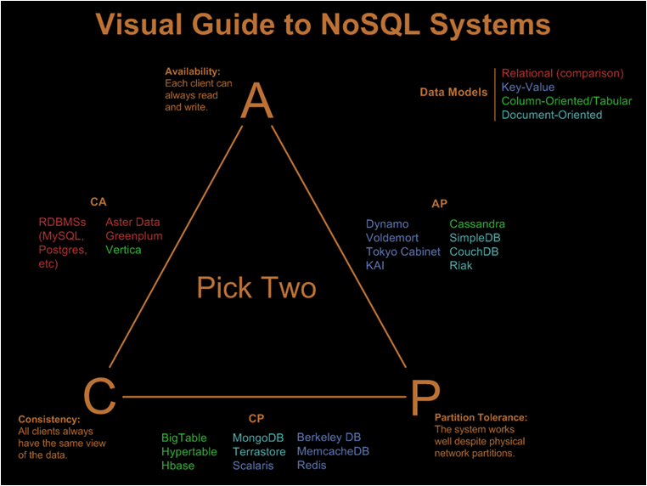
Consistency

Slide 58
Consistency
Level | Description
ANY | A write must be written to at least one node. If all replica nodes for the given row key are down, the write can still succeed once a hinted handoff has been written. Note that if all replica nodes are down at write time, an ANY write will not be readable until the replica nodes for that row key have recovered.
ONE | A write must be written to the commit log and memory table of at least one replica node.
TWO | A write must be written to the commit log and memory table of at least two replica nodes.
THREE | A write must be written to the commit log and memory table of at least three replica nodes.
QUORUM | A write must be written to the commit log and memory table on a quorum of replica nodes.
LOCAL_QUORUM | A write must be written to the commit log and memory table on a quorum of replica nodes in the same data center as the coordinator node. Avoids latency of inter-data center communication.
EACH_QUORUM | A write must be written to the commit log and memory table on a quorum of replica nodes in all data centers.
ALL | A write must be written to the commit log and memory table on all replica nodes in the cluster for that row key.

